Slide 1
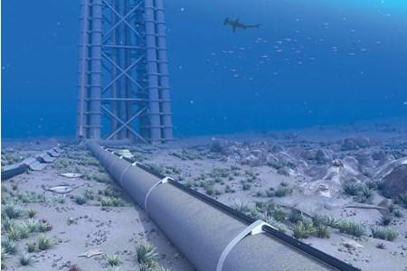

Offshore Pipeline Mechanical Design
Presented by:
Adham Ossama Hassan | 4973
Mohamed Ashraf Abdelaziz | 4760
Mohamed Ahmed Daoud | 4550
Ibrahim Mostafa Ibrahim | 4715

Slide 2
Results
Material is AISI 1018 Steel
Pipe Nominal Diameter 40mm
Pipe Thickness 5.08mm
Flow Speed 5 m/s
Fluid Class D, Location 1, High Risk of Failure
Stress Calculated, External Pressure loads

Slide 3


